Slide 1
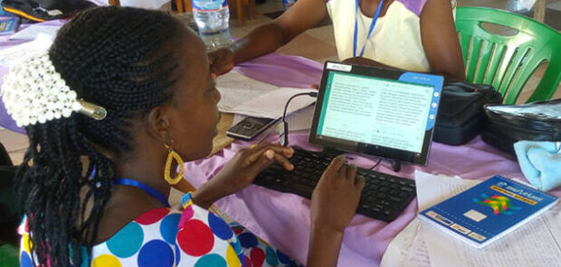
The 8 Steps of MAST
Topic 3: Session 2

Slide 2
The Last 4 Steps: Checking
Step 5
Self-edit
Compare your blind draft to the source text and make corrections
Step 6
Step 7
Step 8

Slide 3
The Last 4 Steps: Checking
Step 5
Self-edit
Peer editors should not make changes to the draft.
Instead, make notes for discussion.
Work in pairs.
Step 6
Peer Edit
Ask a team member to compare the draft to the source text.
Step 7
Step 8

Slide 4
The Last 4 Steps: Checking
Step 5
Consume
Step 6
Peer Edit
List spiritual and abstract terms, names, and other essential words.
Team may have to create or borrow a word or use a phrase.
Resource: Translation Words
Step 7
Keyword Check
Make a list of keywords and check for accuracy.
Step 8

Slide 5
The Last 4 Steps: Checking
Step 5
Consume
Step 6
Verbalize
Step 7
Keyword Check
At least 3 translators should work together.
Resources: Translation Notes and Translation Questions
Step 8
Verse-by-verse Check
Read the draft one verse at a time and compare to the source text.

Slide 6
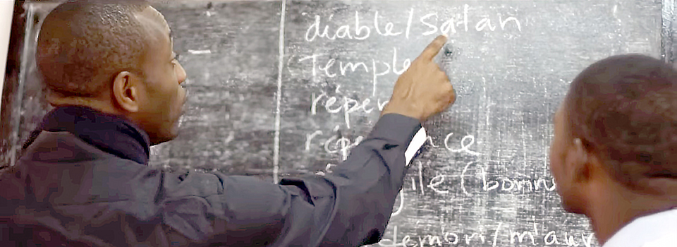
Questions
What has helped you to become more confident in using the steps?
How pleased are you with the product after following the eight steps?

Slide 7
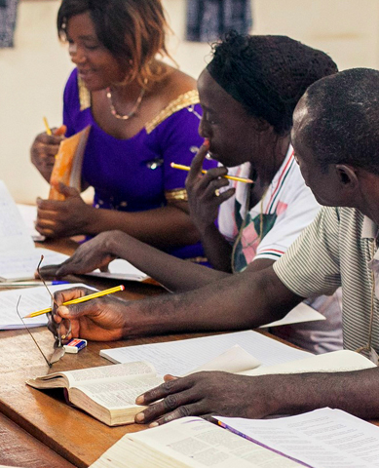

Your Experience and Guidance Can:
encourage new translators who fear that the work is too hard.
help translators understand the value of each of the 8 MAST steps.
help translators understand the need for team work.
Need help? TS@WycliffeAssociates.org

Slide 8


